Slide 1
Lariat Rent-A-Car
Projections for Increasing Profit and Lowering Costs
Presented by:
Pam Robinson, Consultant
Notes:
Hello’s and introductions

Slide 2
Business Objective:
Increase profits and lower costs overall
4 Strategies were developed and analyzed
Remove
Simply remove negative profit vehicles from stock
Remove
Simply remove all low plus negative profits vehicles from stock
Increase
Increase marketing and promotions to draw more of the market share's business
Increase
Increase branch numbers to increase profit
Notes:
*after reviewing the main data, A few things stood out
*With this information at hand, I looked at 4 different scenarios to predict possible increases in profits and lowering costs
*Explain the slide…

Slide 3
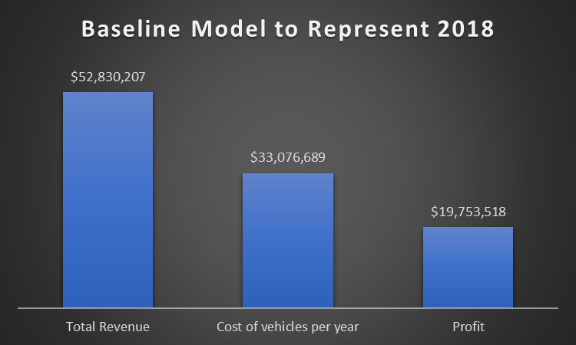
Notes:
This is where we are at for 2018, the basis for the data and calculations

Slide 4
A few definitions
Profitable
Profit for the year >$1500
Low Profit
Profit for the year from $1-$1500
Profit for the year $0 or less (negative)
Rental Day
Total number of days possible to be rented
Negative Profit
Notes:
Before moving into the details of each strategy, I want to show you the way I separated and defined the vehicles that are part of the fleet
Explain slide showing definitions of terms used in this presentation

Slide 5
Strategy 1: Simply Remove all Negative Profit Vehicles from Fleet
*200 Vehicles with different ID#s that profit is negative for the year*
10,263 Rental days on vehicles that cost Lariat money to keep
Average rental price of $162/day
Total loss -$210,884 in 2018
Notes:
Strategy 1
*I identified 200 vehicles with different ID #s that show a negative profit for the year overall
*All these vehicles end up costing Lariat money to have in the fleet
*With a total loss of -$210,884 in 2018, this issue needs to be addressed—even though it only accounts for a small amount of the overall profit for the company

Slide 6
Vehicles will still be needed and there are many other choices in all categories for consumers
200 Negative Profit Vehicles
Represent 12% of entire fleet
=Only 9% of all rental days
Notes:
*If people are needing to rent a vehicle, they will still be renting a vehicle.
*there are choices in all categories that fall into the Negative profit vehicles, also still plenty of similar (and sometimes the same actual vehicle) within the rest of the fleet for them to choose from.
*slide explanation
*Total of 4000 vehicles in the fleet
*Total of 1,460,000 rental days
*Removing these cars will make it 3800 fleet vehicles and 1,387,000 rental days
*currently used rental days for 2018 =325,608
*negative vehicles use up 10,623 of those rental days

Slide 7
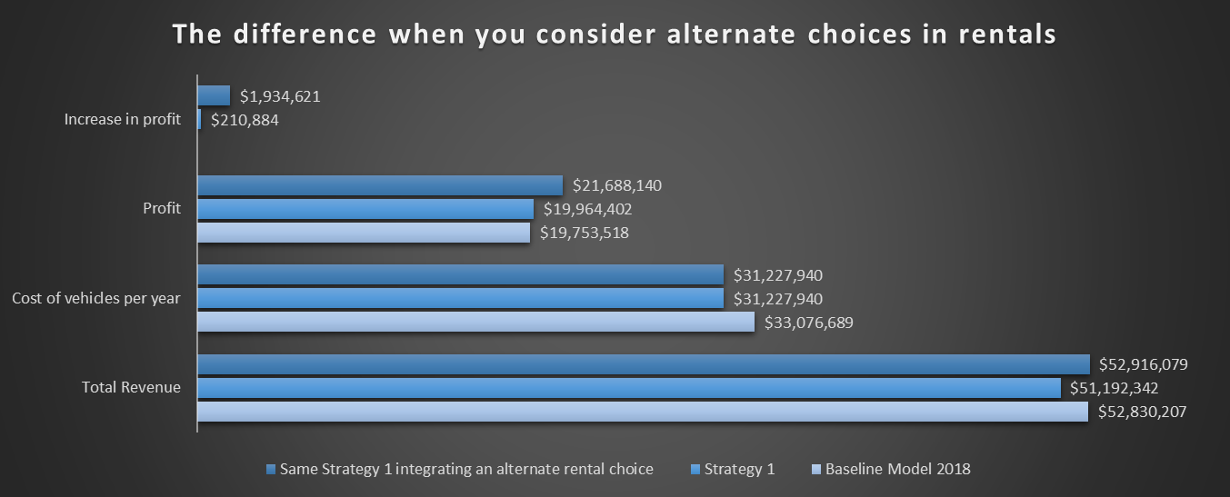
Notes:
*If we were to remove those vehicles from the fleet, and allow a different choice from customers, the profit would increase about 10%
*This includes the overall average per day rental replacing all 10,623 rental days used by the negative profit vehicles
*This is not included in the model sent out because it is completely hypothetical and very difficult to determine which vehicles they would choose to rent
*I used the average rental rate of $162/day to calculate these totals

Slide 8
Strategy 2: Simply remove all Low plus Negative Profit vehicles from stock
 | Baseline Model 2018 | Strategy 2
Total Revenue | $52,830,207 | $48,325,593
Cost of vehicles per year | $33,076,689 | $28,601,140
Profit | $19,753,518 | $19,724,453
Increase in profit |  | -$29,065
 |  | -0.1%
Notes:
*My 2nd Strategy… did not quite work out with the numbers as I hoped…
*Showing it anyway because it was an idea to help boost the profit and cut loss
*Overall removing the low profit vehicles would decrease the profit just over $29,000
*29,000 is still profit so simply removing these vehicles would not gain anything for Lariat

Slide 9
Strategy 3: Marketing and Promotions
In the Car Rentals segment, 82% of total revenue will be generated through online sales by 2025.
Revenue in the Car Rentals segment is projected to reach US$18,223m in 2021.
Source: Statistica (https://www.statista.com/outlook/270/109/car-rentals/united-states#market-revenue)
Notes:
*Marketing and Promotions is not my specialty, but I wanted to include this strategy as an option to increase profit
*After reading some statistics on Statistica.com, I want to make sure we are looking at the future of online sales playing such a HUGE role of sales overall
*I, personally have not booked a rental in person since the 90’s

Slide 10
Lariat can draw more of the current market share with multiple marketing options
Membership has privileges? It also reaps profits for businesses!
Memberships: AARP, AAA
Rewards Programs -- Current return customers
Large Company-- Employee Discounts
Coupons on Social Media –brings NEW customers!
Notes:
*Right now, 30% of the rental market is held by Enterprise….
*One major then they take advantage of that we do not yet… is Membership
*I have worked for a few very large companies and all those companies had group discounts for car rentals
*Social Media followings … THIS is a great place to offer discounts and coupons to draw in new customers

Slide 11
Strategy4: Increase branch numbers to increase profit
We have room to grow!
Current locations:
50 total: 22 in Airports, 28 outside of Airports
We cover 41 Cities and 22 States in the US
Notes:
*My 4th suggested strategy is about increasing branch numbers
*We currently have 50 total branches, including Airport locations and other Office locations in 41 Major cities and 22 States
*There is so much room to grow across the US….

Slide 12
3 New locations: Total Revenue: $56,000,019 Profit Increase: 6%
5 New locations: Total Revenue: $58,113,228 Profit Increase: 10%
10 New locations: Total Revenue: $63,396,248 Profit Increase: 20%
https://drive.google.com/file/d/10nU8yVOEqHV9PrVZODm0XwnC6BEJwfkN/view?usp=sharing
Notes:
*Give the link in chat for above to share my Dashboard and Model
*Let them know they can put any number in that field that will generate the details from any number of locations to include

Slide 13
Conclusion:
Lariat would see the largest significant impact on profit by utilizing all 3 Strategies below:
Remove
Simply remove negative profit vehicles from stock
Increase
Increase marketing and promotions to draw more of the market share's business
Increase
Increase branch numbers to increase profit

Slide 14
Questions ?
Thank you for listening today

